Slide 1


FY 2025 HUD CoC Program Competition PA-511 Bristol/Bensalem, Bucks County​ November 24, 2025
U.S. Department of Housing and Urban Development (HUD)
Notice of Funding Opportunity (NOFO) Competition

Slide 2
Presentation Overview
NOFO Overview & Eligibility​
New Projects
DV Bonus​
Ranking and Priority Overview​
Timeline ​& Deadlines

Slide 3
NOFO Overview
On an annual basis, the U.S. Department of Housing and Urban Development (HUD) publishes a competition called the Notice of Funding Opportunity (NOFO) for regional/local planning bodies known as Continuums of Care (CoC), to apply for federal funding for housing programs.
The Continuum of Care (CoC) is the entity responsible for coordinating funding for local providers to deliver services and rental subsidies to individuals experiencing homelessness.
The Bucks County Department of Housing & Community Development (HCD) is the Collaborative Applicant, CoC Lead Agency, and HMIS Lead for the PA-511 Bristol, Bensalem/Bucks County CoC.
PA-511 Bucks County CoC (The Bucks County Housing Link) will solicit Requests for Applications from eligible organizations that wish to be considered as a new project in the FY 25 Continuum of Care NOFO.

Slide 4
HUD NOFO Changes
Limits permanent housing projects to no more than 30% of CoC’s Annual Renewal Demand (ARD) = $643,011
PH-PSH, PH-RRH, and Joint TH/RRH
Current PH renewal funding is $1,623,320
Current CoC Projects by Type
2025 Required CoC Projects Type
SSO-SO,SSO-CE, SSO Stand Alone, TH
PSH, RRH, Joint TH-RH Projects

Slide 5
HUD NOFO Changes
Tier 1 is equal to 30% of the CoC’s ARD = $643,011
$1,500,360 of renewable funding will need to go into Tier 2

Slide 6
HUD NOFO Changes
Policy goals
End crisis of street homelessness
Direct resources towards outreach, intervention, and assistance that helps people regain self-sufficiency
Prioritize Treatment and Recovery
On-site behavioral health treatment
Wraparound supportive services
Participation requirements

Slide 7
HUD NOFO Changes
Promote Self-Sufficiency
Partnerships with workforce development, employers, childcare, etc. to increase employment income
Advance Public Safety
Partnerships with law enforcement
Minimizing Trauma
Provide trauma informed care and ensure participant safety in programs

Slide 8
FY 2025 NOFO Eligibility
Eligible Fiscal Year (FY) 2025 Project Applications include:
CoC Planning Costs (Collaborative Applicant Only)
Renewal projects eligible for 2025 funds
New projects created via reallocation, CoC Bonus, DV Bonus, or a combination of reallocation and bonus

Slide 9
Request for New Applications

Slide 10
New Projects
New projects created through reallocation or bonus:
CoC is eligible to apply for up to $695,227 (estimate)* for new CoC bonus projects.
New project applications may be created through the reallocation process or as bonus projects for the following components for FY2025:​
Transitional Housing​
Supportive Services Only

Slide 11
Transitional Housing Component (TH)
Provides temporary housing with supportive services with the goal of interim stability and support to successfully move to and maintain permanent housing
Participants in a TH project must have a signed lease, sublease, or occupancy agreement with the following requirements:
Initial term of at least 1 month that ends in 24 months and cannot be extended
Automatically renewable upon expiration, except by prior notice by either party
Grant funds may be used for acquisition, rehabilitation, new construction, leasing, rental assistance, operating costs, and supportive services
Detailed summary of supportive services: Supportive Services – CoC At A Glance – Virtual Binders

Slide 12
TH Component Continued
Supportive Services must be made available to residents through the duration of their residence in the project
Project must require supportive service agreement (contract, occupancy agreement, lease, or equivalent)
Project must demonstrate that it will provide 40 hours per week of customized services for each participant (case management, employment training, substance use treatment, etc.)
May be reduced proportionately for participants that are employed
Does not apply to participants over age 62 or who have a physical or developmental disability, not including substance use disorder
Services may also be provided to former residents of TH projects for up to six months after exiting TH to assist in the household’s transition to independent living

Slide 13
Supportive Services Only Component (SSO)
Projects that provide supportive services – such as conducting outreach to sheltered and unsheltered households experiencing homelessness and providing referrals to other housing or necessary services
SSO projects may only assist program participants for whom the recipient or subrecipient of the funds is not providing housing or housing assistance
SSO projects may provide supportive services to households living in emergency shelters. This includes emergency shelters operated by an organization that is also a recipient of CoC program SSO funds
Detailed summary of supportive services: Supportive Services – CoC At A Glance – Virtual Binders

Slide 14
New Projects
The CoC Executive Committee is requesting applications for the following three project types in the FY25 CoC Competition:
New Projects: The CoC is eligible for an estimated $695,227 in CoC Bonus funds in the HUD FY25 CoC Competition​
New Projects that Serve Survivors of Domestic Violence or Sexual Assault: The CoC is eligible for an estimated $347,614 in DV Bonus funds in the HUD FY25 Competition​
Transition Projects: Application to fund a new CoC project through the reallocation process to transition an eligible CoC renewal project from one program component to another eligible component over a 1-year period. Grants with DV renewal funding are not eligible to use the transition grant process.

Slide 15
DV Bonus Projects
New DV projects created through DV Bonus:
CoC is eligible to apply for up to $347,614 (estimate)* to create DV Bonus projects.
​Project applications must be for a minimum of $50,000.​
​Projects serve survivors of domestic violence, dating violence, sexual assault, or stalking who qualify as homeless und paragraph (4) of 24 CFR 578.3​. DV Bonus projects cannot exclusively serve people fleeing or attempting to flee human trafficking.
Projects that want to be considered for the DV bonus may be:​
Transitional Housing

Slide 16
Next Steps – New Projects
Detailed scoring criteria for new and renewal applications was be sent out via email and posted to the CoC Housing Link website on November 21st, 2025.
Email Intent to Apply by December 3rd, 2025 to hcd@buckscounty.org ​
Email with the subject line, “Notice of Intent to Apply – Organization Name.” Applicant will receive email confirmation notice from HCD within 5 business days.
Submit completed project application in e-snaps and by December 10th, 2025. Applications submitted in e-snaps are automatically sent to the CoC Collaborative Applicant.
Please note: new applicants/staff must sign-up for an e-snaps account.

Slide 17
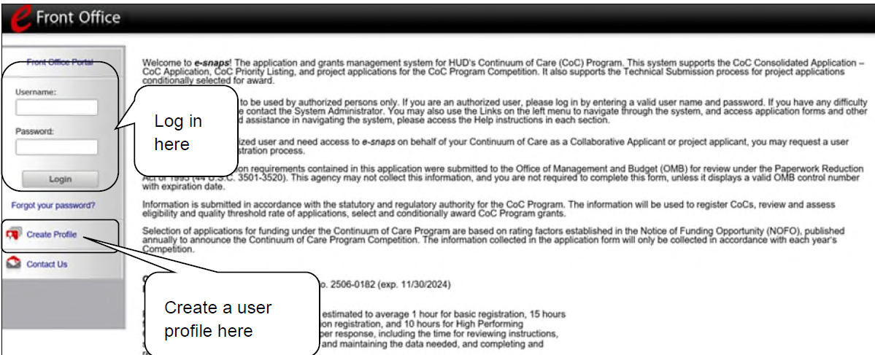
E-snaps - Registration for New Users
Step by Step Description for new users:
Direct your Internet browser to https://esnaps.hud.gov/.
New Users: Create an e-snaps username and password by selecting the "Create Profile" link. Then, log in.
Note: New e-snaps users have access to e-snaps but they do not yet have access to a specific e-snaps account until added as a Registrant.
For more information on e-snaps and CoC program Registration visit:
e-snaps : CoC Program Applications and Grants Management System - HUD Exchange

Slide 18
Ranking and Priority Overview

Slide 19
Ranking & Priority Listing
A 2025 Priority Listing will be created for all projects submitted – each project must be:
Reviewed and accepted or rejected by the CoC, and ​
Ranked as Tier 1 or Tier 2.
Note that Tier 1 is equal to 30% of the CoC’s Annual Renewal Demand (ARD). ​
Detailed scoring criteria for new and renewal applications was sent out via email and posted to the CoC Housing Link website on November 21st, 2025.

Slide 20
Project Application Reviews
Reviews take place prior to scoring & ranking:
Eligibility Threshold Review
All renewal and new projects
Quality Review
All new projects
Projects that do not meet either the eligibility or quality review will be rejected and notified by the Collaborative Applicant (HCD) via email.

Slide 21
New Project Scoring
A CoC New Project Review Committee will review and score all new project applications.
Due to limited availability of CoC and DV bonus funds, new projects will be scored against each other to determine the order in which new project(s) will be included in the ranking based on funding availability.
Maximum point values will only be awarded if applicant fully responds to all parts of each rating criteria. Partial point values will be awarded if applicant effectively responds to parts of each rating criteria.
The CoC Executive Committee, as the governing board, will review and approve the scoring, ranking, rejection, and reduction of all new and renewal project applications on the Project Priority Listing prior to submission to HUD.

Slide 22
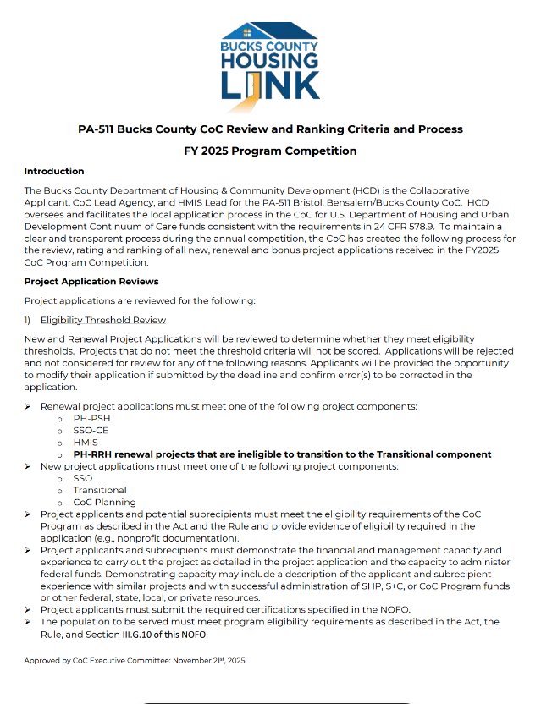
Project Scoring and Ranking Criteria
Key Points:
Renewal projects that have been in operation for less than a year and have not yet submitted an APR will be automatically awarded the APR points and scored on the project application and narrative related questions for the project type.
Renewal project applications must meet one of the following project components:
PH-PSH
SSO-CE
HMIS
PH-RRH renewal projects that are ineligible to transition to the Transitional component
New project applications must meet one of the following project components:
SSO
Transitional
CoC Planning

Slide 23
Timeline & Deadlines

Slide 24
HUD Requirements
Applicants submit via e-snaps no later than December 10th, 2025 ​
Applications submitted after the submission deadline will not be considered. ​
Applicants will be notified of inclusion, rejection, or reduction by December 29th, 2025. ​(To meet HUD’s deadline of no later than 15 days before HUD’s submission deadline.) ​
If rejected or reduced, the project applicant must be notified in writing with a reason for the decision.
Considering the requirements stated, the following schedule applies (next slide):

Slide 25
Bucks County Deadlines
November 17th | 2024 CoC NOFO and CoC Local Program Competition Deadlines are distributed via the CoC email distribution list and posted to the CoC Housing Link website​
December 3rd | Project Applicants must email Notice of Intent to Apply to hcd@buckscounty.org​rg
December 10th | Project Applicant must submit completed Project Application in e-snaps.
December 11th- 16th | CoC New Project Review Committee reviews and scores new project applications.
December 19th | CoC Executive Committee completes review of scoring and ranking and votes on inclusion, exclusion, and ranking of Project Applications for Priority Listing​
December 29th | CoC Collaborative Applicant (Housing & Community Development) notifies Project Applicants via email on inclusion or rejection in Bucks County CoC’s Consolidated Application Priority Listing​.
January 12th | CoC Collaborative Applicant submits Bucks County CoC Consolidated Application, inclusive of all Project Applications and Priority Listing, to HUD via e-snaps.

Slide 26
Questions?

Slide 27
Resources
Next Steps:
Email Intent to Apply by December 3rd, 2025 to hcd@buckscounty.org ​
Submit completed project application in e-snaps by December 10th, 2025.
For any questions, email: hcd@buckscounty.org​
HUD NOFO: Search Results Detail | Grants.gov
E-snaps toolkit: https://www.hudexchange.info/resource/6170/esnaps-101-toolkit/ ​

Slide 28
Thank you!

